Slide 1
BCSE309L – Cryptography and Network Security

Slide 2
Message Authentication Code
(MAC)

Slide 3
Message Authentication Code (MAC)
A hash function such as SHA was not designed for use as a MAC and cannot be used directly for that purpose, because it does not rely on a secret key.
There have been a number of proposals for the incorporation of a secret key into an existing hash algorithm. The approach that has received the most support is HMAC.
HMAC has been issued as RFC 2104, has been chosen as the mandatory-to-implement MAC for IP security, and is used in other Internet protocols, such as SSL.
HMAC has also been issued as a NIST standard (FIPS 198).

Slide 4
Message Authentication Code (MAC)
Message authentication ensures Integrity & source legality.
A MAC is an algorithm that requires the use of a secret key.
A MAC takes a variable length message & a secret key as Input and produces an authentication code.
A recipient is possession of the secret key can generate an authentication code to verify the Integrity of the message
MAC = MAC(K,M)
Finally from Source M+MAC → Transmitted to destination
M→ Tomorrow is an instructional day K=53
MAC = MAC(K,M)
= MAC(53, Tomorrow is an instructional day)
= 12345
Tomorrow is an instructional day+12345 → Transmitted to destination

Slide 5
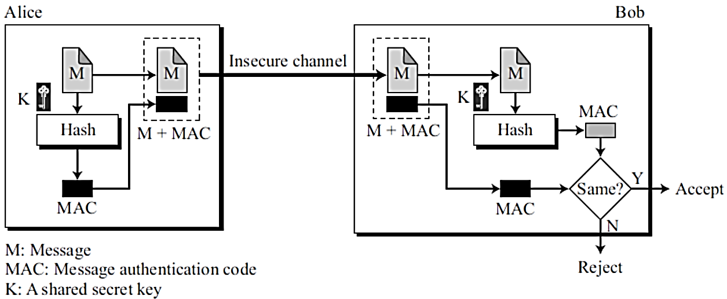
Message Authentication Code (MAC)
Tomorrow is an instructional day+12345

Slide 6
Message Authentication Code (MAC)
Tomorrow is an instructional day+12345
Tomorrow is holiday+12345
Hacker – altered the message

Slide 7
Message Authentication Code (MAC)
Tomorrow is an instructional day+12345
Tomorrow is holiday+12345
Hacker – altered the message
Tomorrow is holiday
77234
12345
No matching of hash code

Slide 8
Message Authentication Code (MAC)
The message plus MAC are transmitted to the intended recipient.
The recipient performs the same calculation on the received message, using the same secret key, to generate a new MAC.
The received MAC is compared to the calculated MAC.
If we assume that only the receiver and the sender know the identity of the secret key, and if the received MAC matches the calculated MAC, then it will accept otherwise, it will reject.

Slide 9
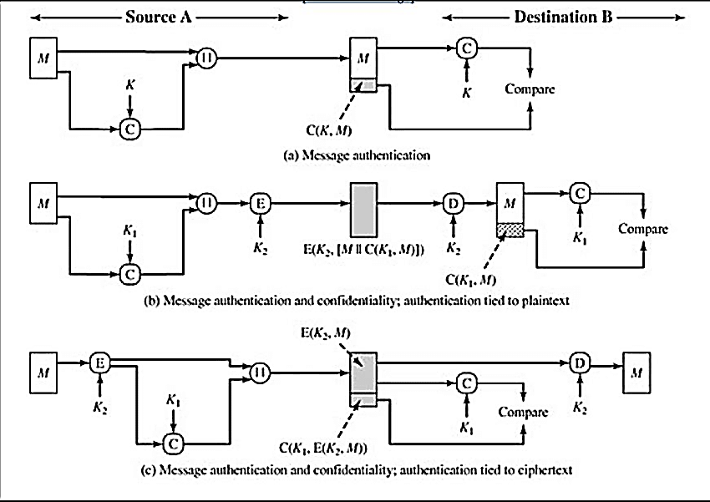
Basic Uses of Message Authentication code (MAC)
Confidentiality, Integrity and Authentication is achieved

Slide 10
Hash Based Message Authentication Code (HMAC)

Slide 11
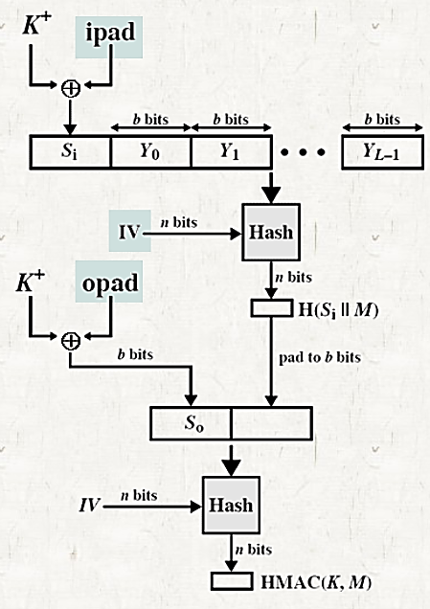
HMAC
IV = initial value input to hash function
M = message input to HMAC
Y – L number of 1024 bit blocks
K = secret key
= padded zeros to left to make it 1024 bits
ipad = 00110110 repeated b/8 times
opad = 01011100 repeated b/8 times
NOTE:
Assume hashing – SHA512. so each block is 1024 bit.
b=1024
b/8=128
So 128 times we need to repeat 00110110 to generate ipad
Ex: 00110110 00110110 00110110 00110110 00110110 00110110 …
ipad= 8*128=1024 bits
128 times we need to repeat 01011100 to generate opad
Ex: 01011100 01011100 01011100 01011100 01011100 01011100 …
1024 bits
1024 bits
1024 bits
1024 bits

Slide 12
HMAC
IV = initial value input to hash function
M = message input to HMAC
Y – L number of 1024 bit blocks
K = secret key
= padded zeros to left to make it 1024 bits
ipad = 00110110 repeated b/8 times
opad = 01011100 repeated b/8 times
NOTE:
Assume hashing – SHA512. so each block is 1024 bit.
b=1024
b/8=128
So 128 times we need to repeat 00110110 to generate ipad
Ex: 00110110 00110110 00110110 00110110 00110110 00110110 …
ipad= 8*128=1024 bits
128 times we need to repeat 01011100 to generate ipad
Ex: 01011100 01011100 01011100 01011100 01011100 01011100 …
1024 bits
1024 bits
1024 bits
1024 bits
1024 bits
1024 bits

Slide 13
HMAC
Expanded Key S_{i} = K⁺ XOR ipad
1024 bit 1024 bit 1024 bit
IV = initial value input to hash function
M = message input to HMAC
Y – L number of 1024 bit blocks
K = secret key
= padded zeros to left to make it 1024 bits
ipad = 00110110 repeated b/8 times
opad = 01011100 repeated b/8 times
NOTE:
Assume hashing – SHA512. so each block is 1024 bit.
b=1024
b/8=128
So 128 times we need to repeat 00110110 to generate ipad
Ex: 00110110 00110110 00110110 00110110 00110110 00110110 …
ipad= 8*128=1024 bits
128 times we need to repeat 01011100 to generate ipad
Ex: 01011100 01011100 01011100 01011100 01011100 01011100 …
1024 bits
1024 bits
1024 bits
1024 bits
1024 bits
1024 bits

Slide 14
HMAC
Expanded Key S_{i} = K⁺ XOR ipad
1024 bit 1024 bit 1024 bit
IV = initial value input to hash function
M = message input to HMAC
Y – L number of 1024 bit blocks
K = secret key
= padded zeros to left to make it 1024 bits
ipad = 00110110 repeated b/8 times
opad = 01011100 repeated b/8 times
NOTE:
Assume hashing – SHA512. so each block is 1024 bit.
ipad:
b=1024
b/8=128
So 128 times we need to repeat 00110110 to generate ipad
Ex: 00110110 00110110 00110110 00110110 00110110 00110110 …
ipad= 8*128=1024 bits
opad:
128 times we need to repeat 01011100 to generate ipad
Ex: 01011100 01011100 01011100 01011100 01011100 01011100 …
1024 bits
1024 bits
1024 bits
1024 bits
1024 bits
1024 bits
1024 bits
SHA512

Slide 15
HMAC
Expanded Key S_{i} = K⁺ XOR ipad
1024 bit 1024 bit 1024 bit
IV = initial value input to hash function
M = message input to HMAC
Y – L number of 1024 bit blocks
K = secret key
= padded zeros to left to make it 1024 bits
ipad = 00110110 repeated b/8 times
opad = 01011100 repeated b/8 times
NOTE:
Assume hashing – SHA512. so each block is 1024 bit.
ipad:
b=1024
b/8=128
So 128 times we need to repeat 00110110 to generate ipad
Ex: 00110110 00110110 00110110 00110110 00110110 00110110 …
ipad= 8*128=1024 bits
opad:
128 times we need to repeat 01011100 to generate ipad
Ex: 01011100 01011100 01011100 01011100 01011100 01011100 …
1024 bits
1024 bits
1024 bits
1024 bits
1024 bits
1024 bits
512 bits
SHA512
1024 bits
1024 bits
512 bits
512 bits
1024 bits
1024 bits
1024 bits
1024 bits
512 bits
512 bits

Slide 16
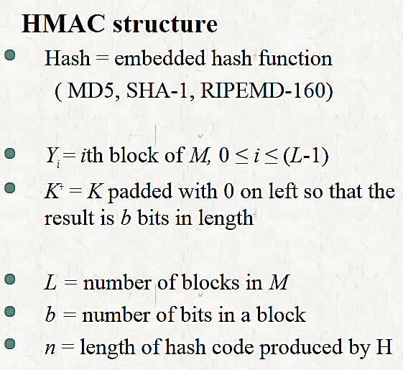
HMAC

Slide 17
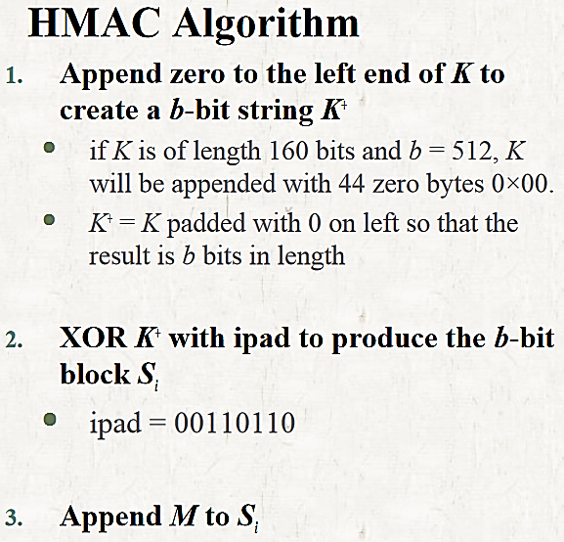
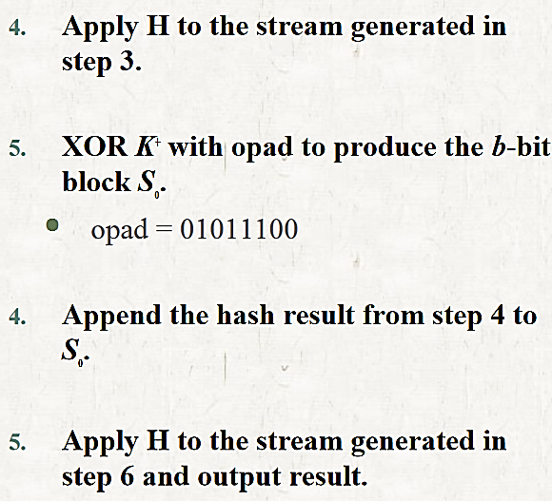
HMAC

Slide 18
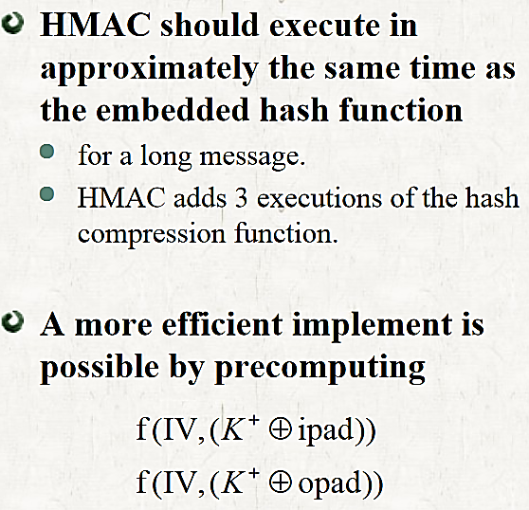
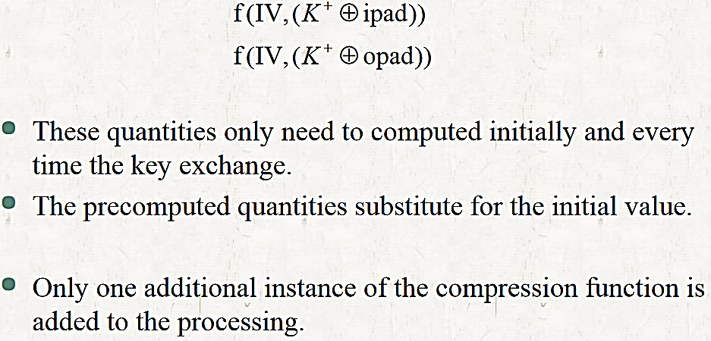
HMAC

Slide 19
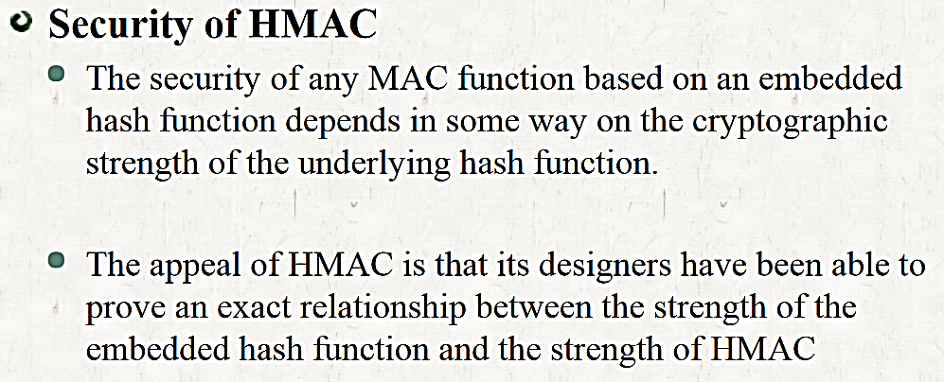
HMAC

Slide 20
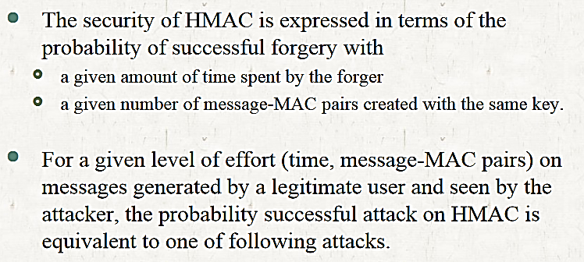
HMAC

Slide 21
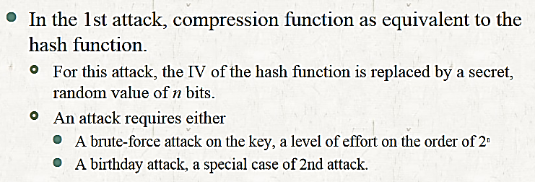
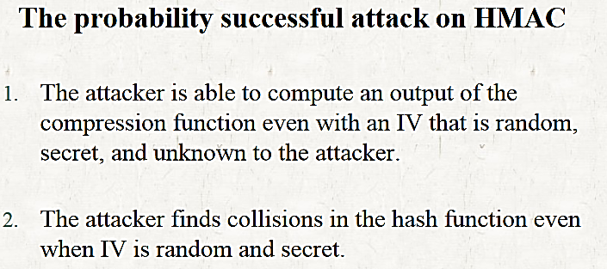
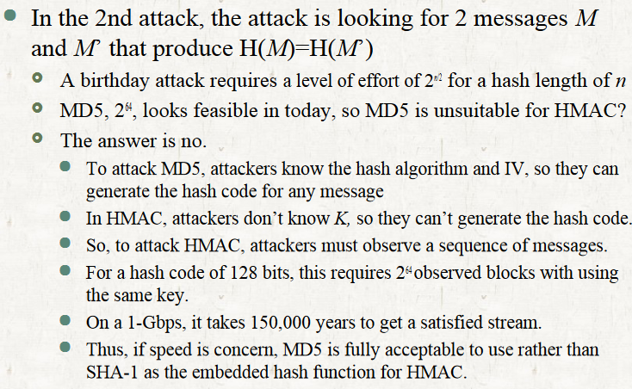
HMAC

Slide 22
Birthday Attack

Slide 23
A birthday attack is an attack that occurs when someone exploits the mathematics behind the birthday problem in probability theory to launch a cryptographic attack.
The birthday problem states that in a group of 23 people, there’s a 50% chance that at least two will have the same birthday.
This probability increases rapidly as the group size gets bigger. For instance, in a group of 50 people, the likelihood is already over 97%.

Slide 24
Birthday Attack
It is cryptographic attack that belongs to a class of brute force attacks
It is used against the cryptographic hash function
Assume Birthday of the student → Day is March 17
Probability that at least one student is born on that day is
1-(364/365)^{n}
Probability that at least one student has the same birthday as any other student
1 - 365!/((365 - n!) * (365^{n})) (substituting n = 30 here)

Slide 25
Probability that at least one student is born on that day is
1-(364/365)^{n}
For example, if the teacher fixes a particular date say October 10, then the probability that at least one student is born on that day is 1 – (364/365)³⁰ which is about 7.9%.

